Slide 1
Comparative Advantage

Slide 2
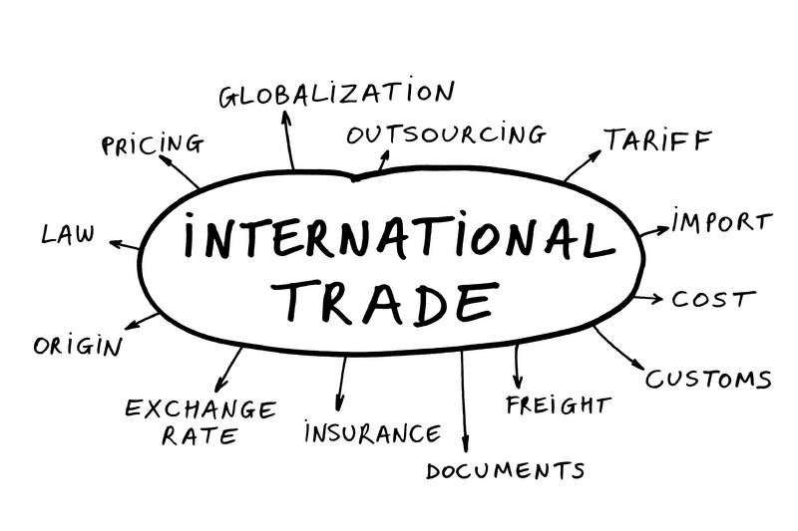

Slide 3
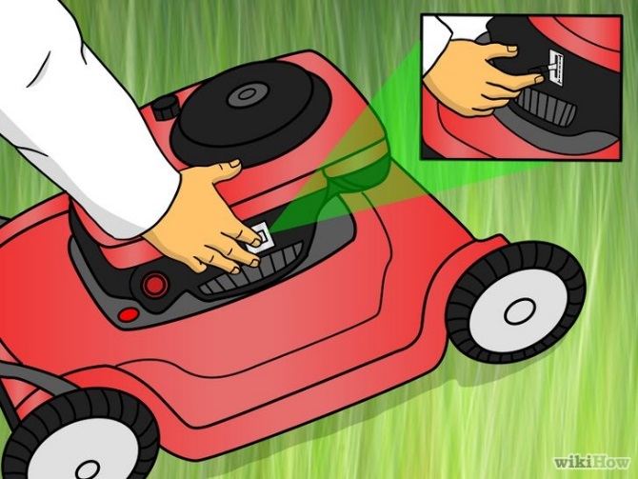
Bill Gates Doesn’t Mow the Lawn
Microeconomic
Application

Slide 4
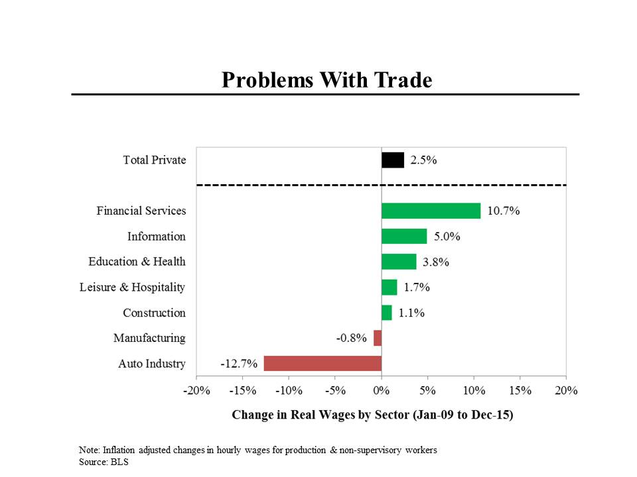
Why do many believe in Protectionism?

Slide 5
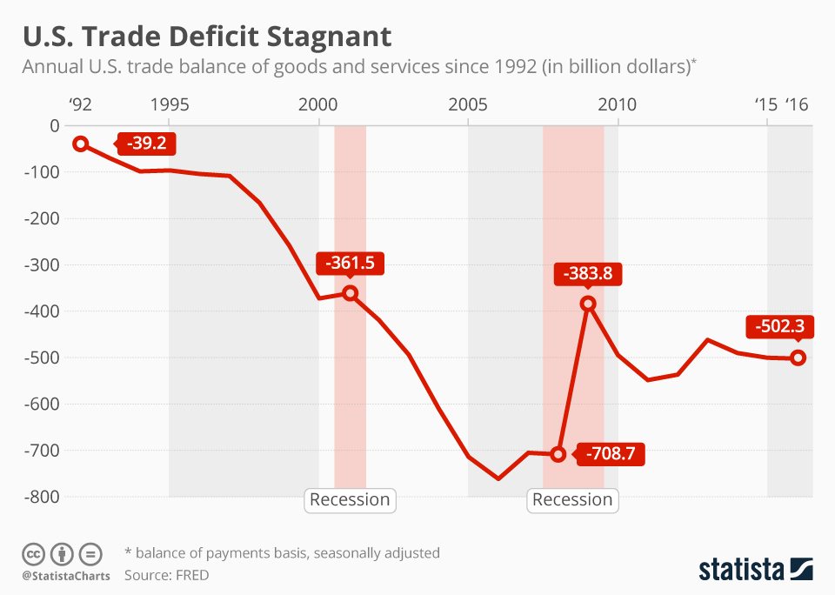
US Trade Balance

Slide 6
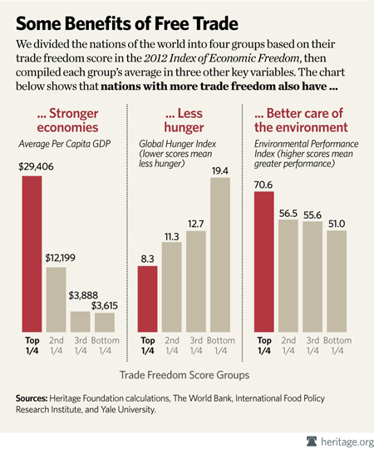
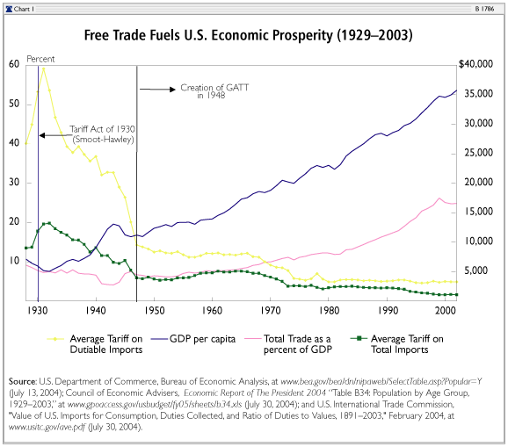
Should globalization be promoted?

Slide 7
Comparative Advantage Key Terms
International Trade (Open Economy)
Exports and Imports
The PPC Graph
Opportunity Costs
Absolute Advantage
Comparative Advantage
Specialization

Slide 8
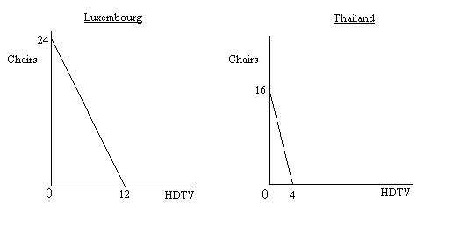
The PPC Connection
Who has the absolute advantage in producing chairs? HDTVs?

Slide 9
Absolute Advantage
Luxembourg has the Absolute Advantage in the production of both products
24>16 Chairs
12>4 HDTVs
But according to David Ricardo’s theory international trade should be based on comparative advantage

Slide 10
Calculating Comparative Advantage

Slide 11
Country A
In one day Country A can either produce 6 units of food or 3 units of clothing. Not both.
For Every unit of food they give up 1/2 a unit of clothing and for every unit of clothing they produce they give up 2 units of food.
What is given up is called………………………

Slide 12
OPPORTUNITY COSTS!
In the comparative advantage matrix the production relationship is always reciprocal.
In Country B 1 unit of food costs 2 units of clothing and 1 unit of clothing costs…………
2 units of food (the reciprocal)
Whichever nation has a lower opportunity cost in the production of a good has the comparative advantage

Slide 13
Who has the comparative advantage?
Country A has the comparative advantage in food production.
They only give up ½ unit of clothing while Country B gives up 2 units of clothing for every unit of food they produce.
Country B has the comparative advantage in clothing production for the same reason
Nation’s produce what they have the comparative advantage in and trade for the other
This is called specialization (similar to Adam Smith’s specialization of labor idea)

Slide 14
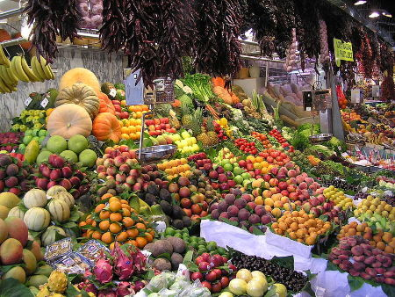
Specialization and the World Market

Slide 15
Former AP Questions
2003 Form B #3
2003 #3
2004 Form B #3
2008 #3
2015 #2
2016 #3
https://apcentral.collegeboard.org/courses/ap-macroeconomics/exam Scroll to the bottom for practice exam questions and answers.

